Slide 1
Interquartile Range
IQR

Slide 2
What Is the Interquartile Range (IQR)?
In statistics, the interquartile range (IQR) is the difference between the third quartile of your data and the first quartile of your data.
A quartile is one of three markers that divide your data into four equally sized groups, each containing roughly a quarter of your data points.
The first quartile (also called the lower quartile or Q1) marks the 25th percentile of your data, and the third quartile (also called the upper quartile or Q3) marks the 75th percentile.

Slide 3
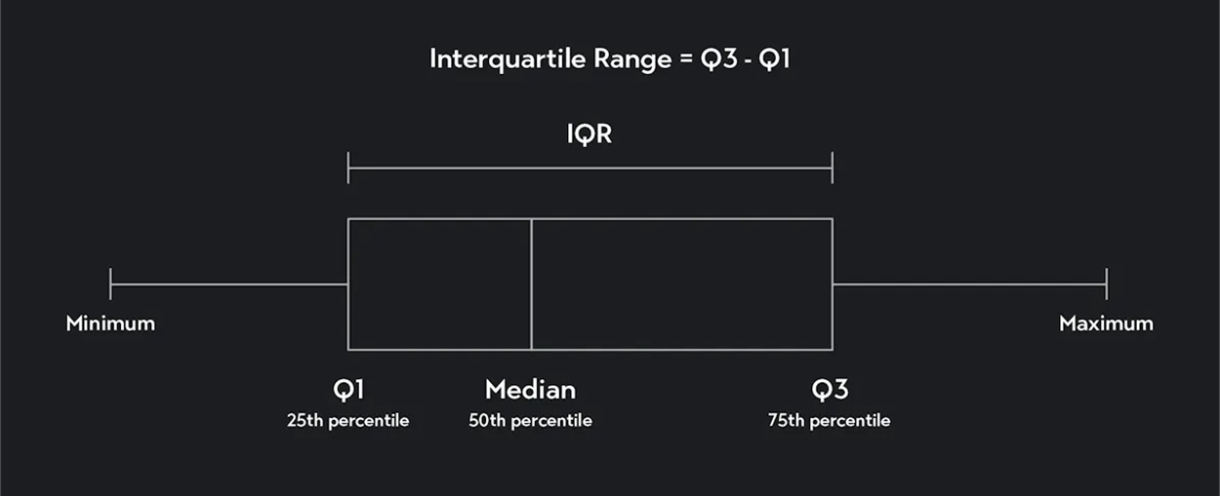

Slide 4
Importance of Interquartile Range in Statistics
The interquartile range is useful because it tells you how spread out the middle 50 percent of your data is. It gives you the range of values between the 25th percentile and the 75th percentile.
The IQR is also useful as it can be used to identify outliers.

Slide 5
How To Calculate Interquartile Range
Step 1. Count & Arrange the Data Points
Count the number of data points and arrange them from smallest to largest. Arrange your data in ascending order from the lowest to the highest value and find the total (n) number of data points.
If you have 10 data points, for example, n=10.
Step 2. Calculate Q1
To find Q1, multiply n by 25/100 (or ¼). This will give you a locator value, L.

Slide 6
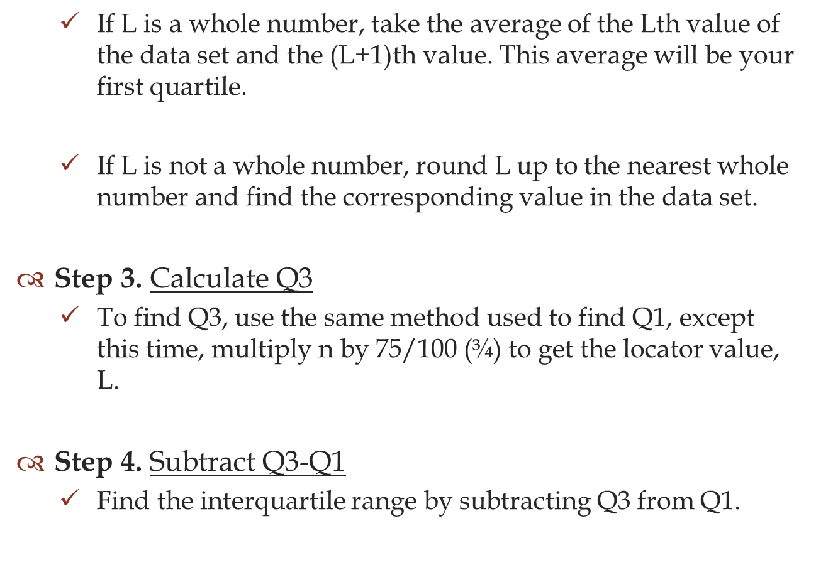

Slide 7
Examples of How To Find the Interquartile Range
Example 1: Find the IQR for the following data set. (Notice that we have already
taken the step of arranging the data in ascending order.)
10,20,30,40,50,60,70,80,90,100
Solution:
n=10
The locator value for Q1 is = 2.5
Q1 = 30
The locator value for Q3 is = 7.5
Q3 = 80
IQR = 80-30 = 50

Slide 8
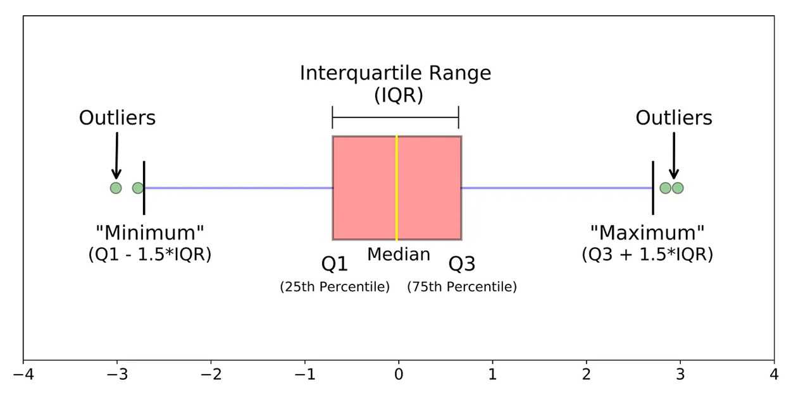
How To Find Outliers With Interquartile Range
In addition to simply calculating the interquartile range, you can use the IQR to identify outliers in your data.
The outlier formula also known as the 1.5 IQR rule
Upper bound quartile - Q3 + (1.5 x IQR)
Lower bound quartile Q1 - (1.5 x IQR) as an outlier.

Slide 9
Why 1.5 times IQR? Why not one or two or any other number?
The interquartile (IQR) method of outlier detection uses 1.5 as its scale to detect outliers because it most closely follows Gaussian distribution.
As a result, the method dictates that any data point that’s 1.5 points below the lower bound quartile or above the upper bound quartile is an outlier.

Slide 10
The Five number summary for the day and night classes is
 | Minimum | Q1 | Median | Q3 | Maximum
Day | 32 | 56 | 74.5 | 82.5 | 99
Night | 25.5 | 78 | 81 | 89 | 98
Find the Day Outlier
IQR = Q3 – Q1
= 82.5 – 56
= 26.5
IQR is 26.5

Slide 11
Lesser Outlier = Q1 – 1.5(IQR)
= 56 – 1.5(26.5)
= 56 – 39.75
= 16.25
Lesser Outlier is 16.25. There is no lesser Outlier present in day dataset because minimum value is 32.
Upper Outlier = Q3 + 1.5(IQR)
= 82.5 + 1.5(26.5)
= 82.5 + 39.75
= 122.25
Upper Outlier is 122.25. There is no Upper Outlier present in day dataset because maximum value is 99.

Slide 12
Find the Night Outlier
IQR = Q3 – Q1
= 89 – 78
IQR = 11
Lesser Outlier = Q1 – 1.5(IQR)
= 78 – 1.5(11)
= 78 – 16.5
= 61.5
Lesser Outlier is 61.5. Lesser Outlier present in night dataset because minimum value is 25.5.
Upper Outlier = Q3 + 1.5(IQR)
= 89 + 1.5(11)
= 89 + 16.5
=105.5
Upper Outlier is 105.5.There is no Upper Outlier present in night dataset because maximum value is 98.

Slide 13
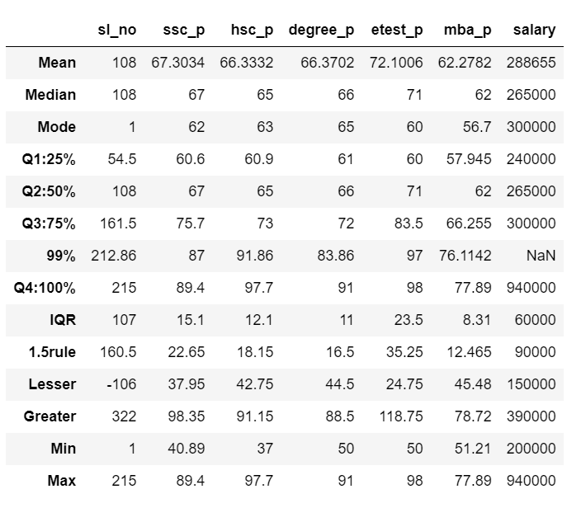
Report for IQR of Placement dataset

Slide 14
Below is the result of Lesser and Greater Outlier of Placement.csv file
 | sl_no | ssc_p | hsc_p | degree_p | etest_p | mba_p | salary
Lesser | Not Present | Not Present | Present | Not Present | Not Present | Not Present | Not Present
Greater | Not Present | Not Present | Present | Present | Not Present | Not Present | Present

